Slide 1
5. 作文 15％
1）简介： 写作文
2）出题形式：
·话题作文，主题就是单元主题选一个（和老师给的作文题目基本一致）
·150词+
3）教材内教材外考察比例：
只考课本各单元的话题
（如果任课英语老师有每单元留批改网作文的习惯，那么期末考的作文会极大概率与其中一篇极度类似）

Slide 2
4）小技巧：
①如果你觉得把每个单元的作文都准备了太累了，那么其实准备一点万能写作小套路来帮助你快速写出一篇还不错的文章其实也是可以的
（因为大英的题量还是比较大的，所以大部分同学写到作文都没多少时间了，可以说是一个比一个写的拉，此时但凡你能写出一篇完整而且还不错的作文其实就已经领先太多了）
②比如，我下面给大家分享一下我平时经常用的一些作文套路:
(相信大家也有自己的作文套路，但是这种东西嘛，多多益善啦)

Slide 3
⭐开头可以用这些：
·Currently,......（the ubiquitous phenomenon that ....） does exert such a profound effect on our life that it revolutionizes the way of people’s living and thinking.
·Currently, there is a widespread concern regarding...，which has attracted extensive attention of the society, which can be found in TV programs, newspapers, university courses and many aspects of our everyday life
·Based on a famous “Butterfly Effect Theory”，a casual/ting phenomenon, such as ......(文章主题), may end up with huge dreadful effects

Slide 4
⭐文章主体部分一般就是分析这个主题是好是坏，好就夸，坏就骂：
（当然无论是夸还是骂，都要分多个层面）
如：
·First and foremost, Confucianism teaches us to lay modesty in an indispensable status, which will definitely pave the way for our future.The individual with modesty, undoubtedly, invariably turns in more outstanding performance among peers. Through modesty, not only can they achieve the goal of impelling people draw far closer, but will also better establish their career, fit into the society, and even attain certain social status.
具有...可以在同龄人中更出类拔萃。通过....，他们不仅可以积累财富、也可以更好地创造职业生涯、融入社会、甚至获得一定社会地位。

Slide 5
⭐文章主体部分一般就是分析这个主题是好是坏，好就夸，坏就骂：
（当然无论是夸还是骂，都要分多个层面）
如：
·Additionally, another quintessence of Confucianism is respecting as well as considering for others. From my perspective, it is indeed a kind of lubricant for interpersonal relationships. With its seemingly magic power, you have no idea how efficient an instrument it can be for individuals to bridge the gap between people and even change the world.
在我看来，它真是一种人际关系的催化剂。伴随着它近乎魔力的力量，你根本想不到它将是人与人之间消除隔阂甚至改变世界的多么高效的一个工具

Slide 6
⭐在写最后一点前，还可以再用一些假大空的分析句式再让文章看着更高级一点
如：
·In addition, We live in an unprecedented age of globalization, where everything is increasingly mobile across national boundaries , and our conceptions are no exception.
Under these circumstances，some negative ideas appear , such as the rise of individualism, worship crisis, the erosion of utilitarianism and pragmatism , etc.
另外，我们现处于一个前所未有的全球化时代,很多东西都跨越了国与国边界而流动，我们的观念也不例外。在此情况下，一些消极的观念出现了，比如个人主义抬头、信仰危机、功利主义实用主义的侵蚀等等。

Slide 7
⭐在写最后一点前，还可以再用一些假大空的分析句式再让文章看着更高级一点
放在文章里就是这样的：
·Last but not least, with the quickening pace of modern life and the fierce competition of society, we live in an unprecedented age of globalization, where everything is increasingly mobile across national boundaries , and our conceptions are no exception. During it, some negative ideas appear , such as the rise of individualism, worship crisis, the erosion of utilitarianism and pragmatism. However, the methodology contained in Confucianism can equip us college students with a correct world outlook, a better ability of thinking as well as a more expansive perspective.
最后，伴随着现代社会的快速发展和激烈的竞争，我们现处于一个前所未有的全球化时代,很多东西都跨越了国与国边界而流动，我们的观念也不例外。在此情况下，一些消极的观念出现了，比如个人主义抬头、信仰危机、功利主义实用主义的侵蚀等等。然而，儒家思想所蕴含的方法论可以使我们的大学生树立正确的世界观、获得更好的思维能力和更开阔的视野。

Slide 8
⭐在最后再来个经典的“措施型”结尾：
·As far as I'm concerned, more and more practicable measures must be put into practice immediately to improve the current situation. From a national perspective, solely constantly pushing our traditional cultures sounder and stimulate the public's awareness of learning the quietness of Confucianism can keep our nation's flag flying for decades and forever. From our personal perspective, it's high time that we contributed our own efforts to use the methodology contained in Confucianism to establish a brighter future. And above all, remember to take the essence and discard the dregs when confronted with Confucianism. Solely by making its advance with times can we live up to our ancestors' spiritual wealth.
就我看来，我们必须立即采取更多切实可行的措施来改善现状。从国家的角度来看，只要不断地推动我们的传统文化更加健全，激发公众学习儒学的意识，我们国家的旗帜就可以永远飘扬不倒。从我们个人的角度来看，是时候我们贡献自己的力量来尝试着运用儒家思想中的方法来建设一个更加光明的未来。此外最重要的是，面对儒家思想，切记取其精华，去其糟粕。只有与时俱进，才能不辜负祖先的精神财富。

Slide 9
4）小技巧：
①如果你觉得把每个单元的作文都准备了太累了，那么其实准备一点万能写作小套路来帮助你快速写出一篇还不错的文章其实也是可以的
（因为大英的题量还是比较大的，所以大部分同学写到作文都没多少时间了，可以说是一个比一个写的拉，此时但凡你能写出一篇完整而且还不错的作文其实就已经领先太多了）
②比如，我下面给大家分享一下我平时经常用的一些作文套路:
(相信大家也有自己的作文套路，但是这种东西嘛，多多益善啦)
③同样，这些作文套路其实还可以用于平日里批改网的写作之中~

Slide 10
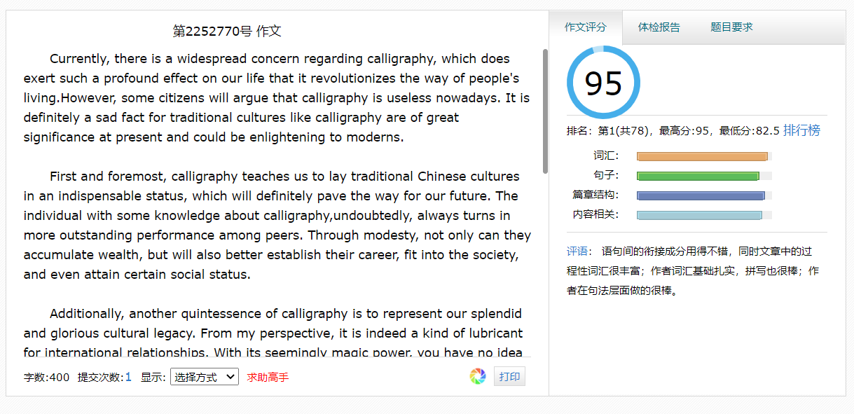
③同样，这些作文套路其实还可以用于平日里批改网的写作之中~
毕竟，机器可比人傻多了hhhhhhhh

Slide 11
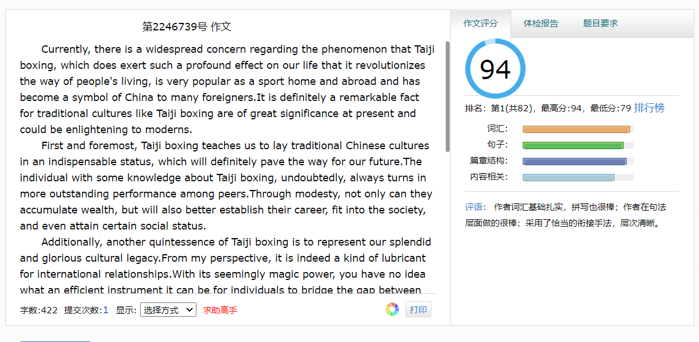
③同样，这些作文套路其实还可以用于平日里批改网的写作之中~
毕竟，机器可比人傻多了hhhhhhhh

